Slide 1

FBA
|
QUANTITATIVE FINANCE
RESEARCH GROUP
Size Factor and Value Factor
Apr 1st, 2023

Slide 2
Outline
Ⅰ. | Size Factor
Ⅱ. | Value Factor
FBA
|
QUANTITATIVE FINANCE
RESEARCH GROUP

Slide 3
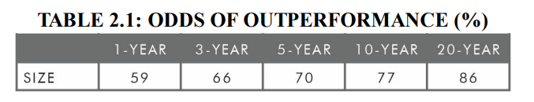
Topic 1. Size Factor - Introduction, Persistency
“The Cross-Section of Expected Stock Returns” (Eugene Fama, Kenneth French)
Development of the Fama–French three-factor model
Added the size and value factors to the market beta factor
Size Factor
Tendency for small-cap stocks to outperform large-cap ones
e.g.) SMB : Small(S) 50% CRSP stocks - Big(B) 30% CRSP stocks
* CRSP Index: US Total Market index
Size premium 3.3 % (1927 ~ 2015, U.S.)
Persistent
Sharpe ratio of the size premium 0.24
FBA
|
QUANTITATIVE FINANCE
RESEARCH GROUP

Slide 4
Topic 1. Size Factor –Pervasiveness, Investability
Pervasive
Can be found also in developed and emerging equity markets around the world
e.g.) MSCI EAFE Small Cap Index 8.4% return(1999 ~ 2015)
MSCI EAFE Index 4.1% return (1999 ~ 2015)
e.g.) Fama-French Emerging Markets Small Cap Index 11.7% return (1989~2015)
Fama-French Emerging Markets Index 10.4% return (1989 ~ 2015)
Investable
Size premium certainly can be captured by live funds
e.g.) BRISX 10.3% return which outperforms CRSP 9-10 Index(Smallest 20% stocks)
* BRISX Index: Bridgeway Ultra-Small Company Market Fund(BRSIX)
FBA
|
QUANTITATIVE FINANCE
RESEARCH GROUP

Slide 5
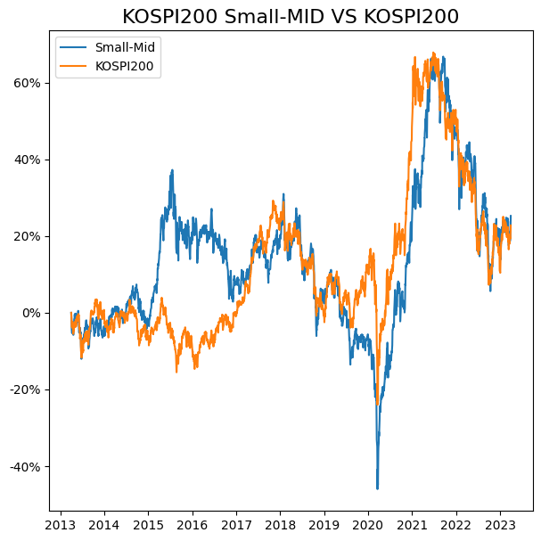
Topic 1. Size Factor – Example1
KOSPI 200 Small-Mid Cap Index VS KOSPI 200 Index * KOSPI200 Small-Mid Cap (Cumulative Return) 25.3% (2013-04~2023-03) * KOSPI200 Cumulative Return (Cumulative Return) 22.8% (2013-04~2023-03)
FBA
|
QUANTITATIVE FINANCE
RESEARCH GROUP

Slide 6
Topic 1. Size Factor – Example2
Market Small-Mid Cap Fund Vs KOSPI Index * 미래에셋성장유망중소형주증권자투자신탁1호 (중형주 80%+소형주 20%, 총보수 1.5%, 설정일:2013.04.18) * NH-Amundi성장중소형주증권투자신탁[주식] (중소형주에 최소 50%이상 투자, 총보수 1.48%, 설정일:2011.06.22)
 | 1M | 3M | 6M | 1Y | 3Y | 5Y | YTD
미래에셋중소형 | 6.6% | 8.0% | 9.0% | -11.9% | 95.5% | 10.6% | 8.0%
NH중소형 | 5.1% | 12.7% | 17.5% | -5.9% | 102.4% | 19.5% | 12.7%
KOSPI | 1.7% | 9.3% | 12.6% | -10.8% | 42.3% | 0.3% | 9.3%
FBA
|
QUANTITATIVE FINANCE
RESEARCH GROUP

Slide 7
Topic 2. Size Factor – Intuitive
Small-cap stocks
- small-cap stocks are more volatile than large-cap stocks
- tends to perform better in good times, and perform worse in bad times(frequent bankruptcy)
(Moon K. Kim and David A. Burnie, authors of the 2002 paper “The Firm Size Effect and the Economic Cycle)
-there is a significant small-firm premium only in periods of expansionary monetary policy
(Gerald Jensen and Jeffrey Mercer, authors of the 2002 paper “Monetary Policy and the Cross-Section of Expected Stock Returns,”)
Small-cap growth anomaly
-produces low returns, high volatility
- Investors have a preference for securities that exhibit positive skewness, hence overpriced.
(Nicholas Barberis and Ming Huang, “Stocks as Lotteries: The Implications of Probability Weighting for Security Prices,” )
- These anomalies cannot be arbitraged due to the limits of short positions, and liquidity
FBA
|
QUANTITATIVE FINANCE
RESEARCH GROUP

Slide 8
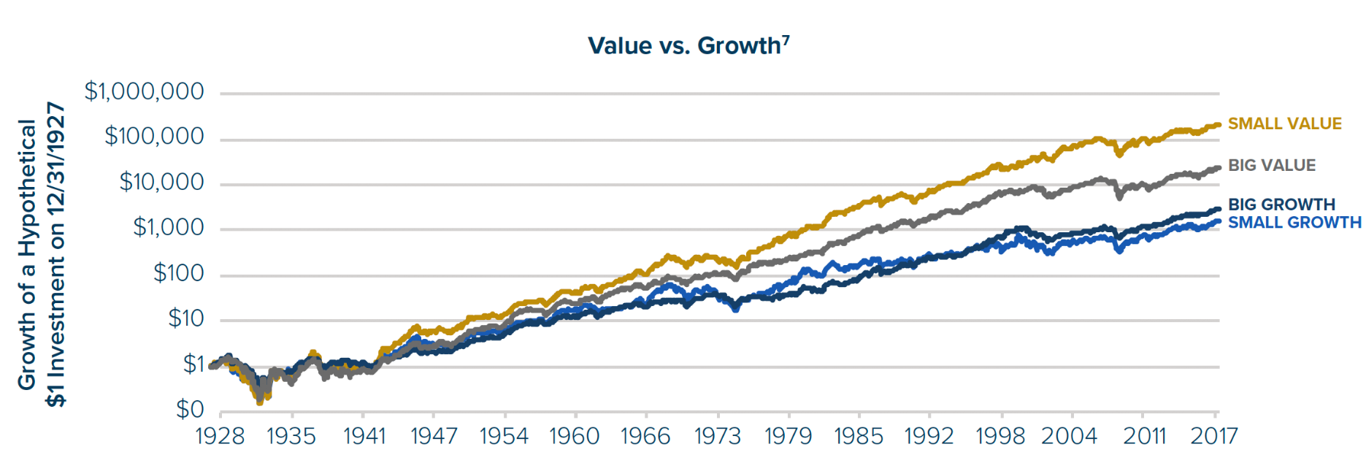
Topic 2. Size Factor – Intuitive
FBA
|
QUANTITATIVE FINANCE
RESEARCH GROUP

Slide 9
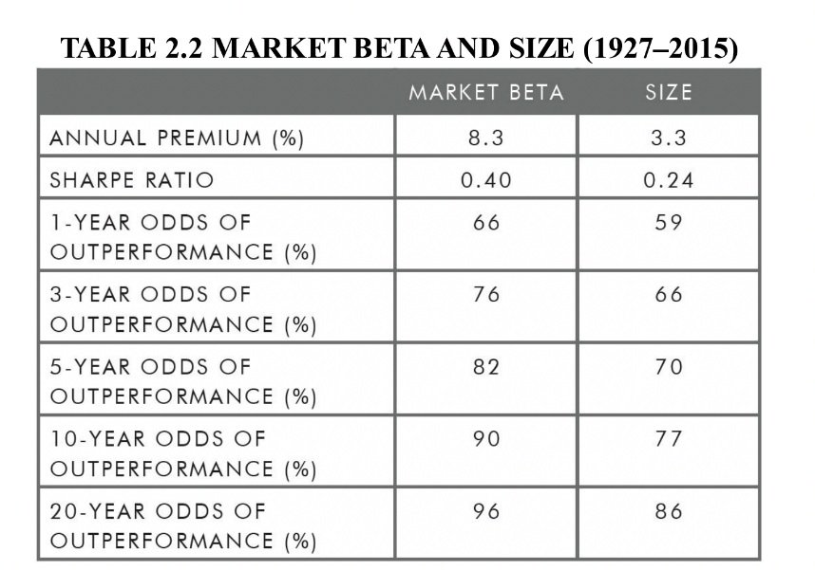
Topic 2. Size Factor – Intuitive
Size Factor & Quality factor
-stocks with low-quality have mostly small sizes
-These characteristics drive the strong negative relation between size and quality
(2015 study “Size Matters, If You Control Your Junk)
-small quality stocks outperform large quality stocks
FBA
|
QUANTITATIVE FINANCE
RESEARCH GROUP

Slide 10
Topic 2. Value Factor - Intuitiveness (Risk-based)
Intuitive (Risk-based Explanation)
Cheap because they tend to be firms in distress, with high leverage, and that face substantial earnings risk
(Nai-fu Chen and Feng Zhang, 1998, “Risk and Return of Value Stocks.”)
Leverage (risk) effect
(Robert F. Peterkort and James F. Nielsen, 2005, “Is the Book-to-Market Ratio a Measure of Risk?”)
Positive relationship between higher stock returns and market leverage
There was NO BtM effect at all to “all-equity” firms
Compensation for higher vulnerability to financial distress
(Motohiro Yogo, 2006, “A Consumption-Based Explanation of Expected Stock Returns”)
Value stocks deliver low returns during recessions
Returns of value stocks are more pro-cyclical than growth stocks
FBA
|
QUANTITATIVE FINANCE
RESEARCH GROUP

Slide 11
Topic 2. Value Factor - Intuitiveness (Risk-based)
Intuitive (Risk-based Explanation)
Largely based on fundamental risk factors within the economy and arises through macroeconomic risk
(Angela J. Black, Bin Mao, and David G. McMillan, “The Value Premium and Economic Activity:
Long-Run Evidence from the United States.”)
value stocks are more sensitive to bad economic news, whereas growth stocks are more sensitive to good economic conditions
When economic expands(industrial production, money supply rises)
Value stocks become less risky relative to growth stocks
Their price increase more
Spread between the high and low BtM stocks narrows
Value premium declines
FBA
|
QUANTITATIVE FINANCE
RESEARCH GROUP

Slide 12
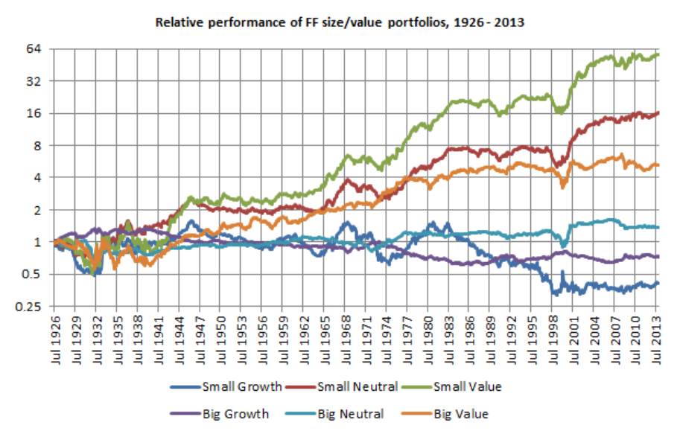
Topic 2. Value Factor - Intuitiveness (Risk-based)
<<A Look Inside The Fama-French 3-Factor Model>>, Kevin Wrotenbery, Feb. 20, 2014.
https://seekingalpha.com/article/2035813-a-look-inside-the-fama-french-3-factor-model
FBA
|
QUANTITATIVE FINANCE
RESEARCH GROUP

Slide 13
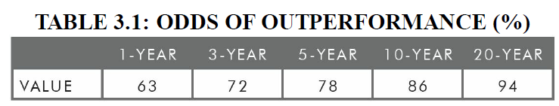
Topic 2. Value Factor - Introduction, Persistency
“The Cross-Section of Expected Stock Returns” (Eugene Fama, Kenneth French)
Development of the Fama–French three-factor model
Added the size and value factors to the market beta factor
Value Factor
Tendency for relatively cheap assets to outperform relatively expensive ones
e.g.) HML : High(H) 30% BtM stocks - Low(L) 30% BtM stocks
* BtM : book-to-market
Value premium 4.8 % (1927 ~ 2015, U.S.)
Persistent
The recent performance is respectively bad
FBA
|
QUANTITATIVE FINANCE
RESEARCH GROUP

Slide 14
Topic 2. Value Factor - Pervasvieness, Inbestiablity
Pervasive
Can be found also in developed and emerging equity markets around the world
e.g.) Fama-French Emerging Growth Index 8.6% annaul avg return (1989 ~ 2015)
Fama-French Emerging Value Index 13.8% annual avg return (1989 ~ 2015)
e.g.) Significant return premium to value in 18 developed market countries with
the strongest performance in Japan
(Clifford Asness, Tobias Moskowitz, and Lasse Pedersen, 2013, “Value and Momentum Everywhere")
Investiable
Value index funds have typically outperformed their growth counterparts
Value premium certainly can be captured by live funds
e.g.) DFA U.S. Large Cap Value Portfolio Institutional Class fund (DFLVX)
outperformed MSCI US Prime Market Value Index, Russell 1000 Value Index
FBA
|
QUANTITATIVE FINANCE
RESEARCH GROUP

Slide 15
Topic 2. Value Factor - Intuitiveness (Risk-based)
Intuitive (Risk-based Explanation)
Cheap because they tend to be firms in distress, with high leverage, and that face substantial earnings risk
(Nai-fu Chen and Feng Zhang, 1998, “Risk and Return of Value Stocks.”)
Leverage (risk) effect
(Robert F. Peterkort and James F. Nielsen, 2005, “Is the Book-to-Market Ratio a Measure of Risk?”)
Positive relationship between higher stock returns and market leverage
There was NO BtM effect at all to “all-equity” firms
Compensation for higher vulnerability to financial distress
(Motohiro Yogo, 2006, “A Consumption-Based Explanation of Expected Stock Returns”)
Value stocks deliver low returns during recessions
Returns of value stocks are more pro-cyclical than growth stocks
FBA
|
QUANTITATIVE FINANCE
RESEARCH GROUP

Slide 16
Topic 2. Value Factor - Intuitiveness (Risk-based)
Intuitive (Risk-based Explanation)
Largely based on fundamental risk factors within the economy and arises through macroeconomic risk
(Angela J. Black, Bin Mao, and David G. McMillan, “The Value Premium and Economic Activity:
Long-Run Evidence from the United States.”)
value stocks are more sensitive to bad economic news, whereas growth stocks are more sensitive to good economic conditions
When economic expands(industrial production, money supply rises)
Value stocks become less risky relative to growth stocks
Their price increase more
Spread between the high and low BtM stocks narrows
Value premium declines
FBA
|
QUANTITATIVE FINANCE
RESEARCH GROUP

Slide 17
Topic 2. Value Factor - Intuitiveness (Risk-based)
<<A Look Inside The Fama-French 3-Factor Model>>, Kevin Wrotenbery, Feb. 20, 2014.
https://seekingalpha.com/article/2035813-a-look-inside-the-fama-french-3-factor-model
FBA
|
QUANTITATIVE FINANCE
RESEARCH GROUP

Slide 18
Topic 2. Value Factor – Intuitiveness (Behavioral-based)
BEHAVIORAL BASED Explanation
“Mispricing”
Testing the mispricing hypothesis
Incongruent value/glamour strategy
Anchoring
Anchoring on the P/E Ratio
Loss-Aversion
“A loss that comes after prior gains is less painful than usual, because it is cushioned by those earlier gains”

Slide 19
Topic 2. Value Factor – Intuitiveness (Behavioral-based)
Testing the Mispricing Hypothesis
Identify potential ex-ante bias
Compare expectations(implied by price multiples) & fundamentals
Successful value strategy if expectations ≠ fundamentals
VALUE / GLAMOUR
BtM ratio ⇒ market’s Expectations
Low BtM (value), High BtM (glamour)
FSCORE
Financial strength ⇒ Fundamentals
Low FSCORE (high fundamental)

Slide 20
Topic 2. Value Factor – Intuitiveness (Behavioral-based)
Testing the Mispricing Hypothesis
RESULT
Expect = Fund ⇒ 0 value/glamour effect
Expect ≠ Fund ⇒ robust & larger& more frequent positive return
Strongest Pricing Errors in…
High BtM(value) + High FSCORE(strong)
Low BtM(growth) + Low FSCORE(weak)
⇒ INCONGRUENT value/glamour strategy
⇒ Existence of MISPRICING
Optimism for Growth Stocks? Anchoring? Confirmation Bias?

Slide 21
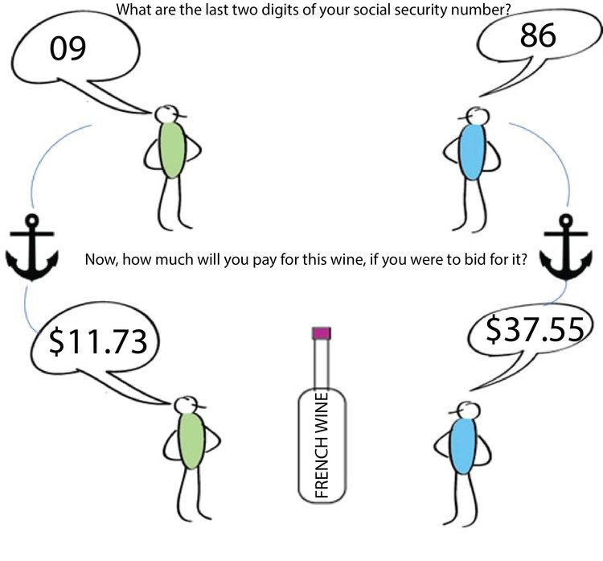
Topic 2. Value Factor – Intuitiveness (Behavioral-based)
Anchoring
Cognitive bias,
putting too much importance
on the initial assessment &
thinking of it as a reference point
! Anchoring on the
P/E ratio !
Fail to adjust
future expectations of the asset

Slide 22
Topic 2. Value Factor – Intuitiveness (Behavioral-based)
Anchoring
Rank stocks by P/E, put into 15 bins ⇒ track their movement & examine returns
RESULT
For two extremes with (+) returns, VALUE > GLAMOUR. (similar s.d.)
Superior VALUE returns in longer-run
1st yr: 5% → 2nd yr: 21% → 3rd yr: 15% → ↓ to little more than GLAMOUR
Next year Loss maker: GLAMOUR 34%, VALUE 25%
GLAMOUR that remains (1/6) 36% return
that moves (5/6) have very poor return, up to 41% loss
VALUE typically remains near the value P/E range
Extreme Loss makers cannot break out of the spiral, 27% delisted
⇒ GLAMOUR investors anchor on the high P/E of growth shares,
ignoring the future change of the bin

Slide 23
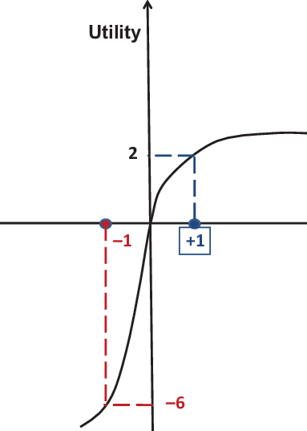
Topic 2. Value Factor – Intuitiveness (Behavioral-based)
Loss Aversion
Being more sensitive on loss than on gains
Whether the individual has recently experienced gains/ losses
⇒ cushioned!
GROWTH- good recent performance,
willing to accept more risk
VALUE- poor recent performance,
require more risk premium
Cf. Momentum effect

Slide 24
Topic 2. Value Factor – Intuitiveness (Behavioral-based)
4. Robust to Various Definitions
METRICS?
Value Premium Exists
across all market caps (though greater in small cap and smaller in large cap)
in non-US developed markets,
and in Emerging markets (largest value premium)
Metrics | BtM | CF-to-Price | Earnings-to-Price
1952-2015 US | 4.1% | 4.7% | 6.3%
1980-2014 developed markets | 6.1% | 8% | 7.3%

Slide 25
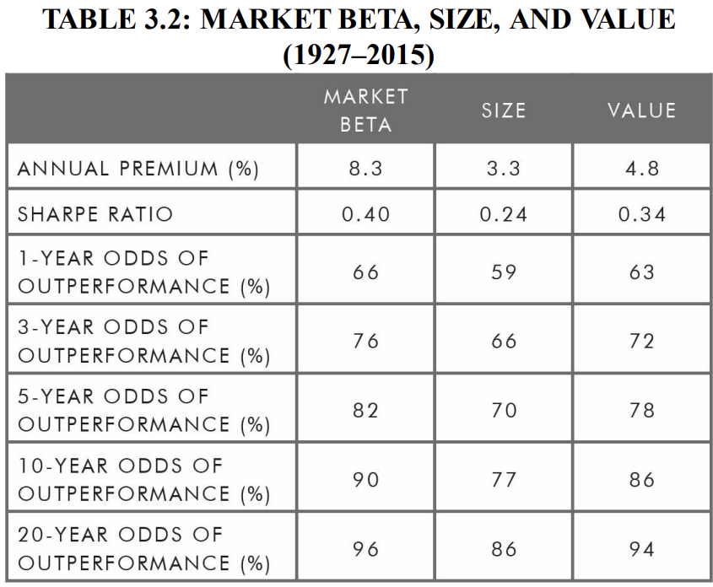
Topic 2. Value Factor – Intuitiveness (Behavioral-based)
Robust to Various Definitions

Slide 26
FBA
|
QUANTITATIVE FINANCE
RESEARCH GROUP
Contact fbaquant@gmail.com Website fbaquant.com

